Slide 1



Introduction to LoRa/LoRaWAN Protocol
Workshop
Nguyen Manh Thao

Slide 2
Workshop Contents
A Fast Introduction to LoRa/LoRaWAN
LoRaWAN Architecture
LoRaWAN Frequency Plans
Hardware: End-Node & Gateway
Network Server
Live Demo
Q & A

Slide 3
A Fast Introduction to LoRa/LoRaWAN

Slide 4
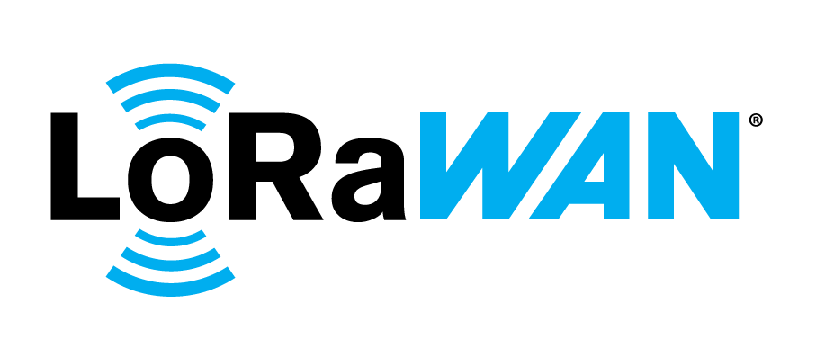
A Fast Introduction to LoRa/LoRaWAN
LoRa stands for Long Range
LoRa is a low-power wide-area network protocol developed by Semtech
LoRaWAN is the communication protocol based in LoRa
LoRaWAN defined by LoRa Alliance

Slide 5
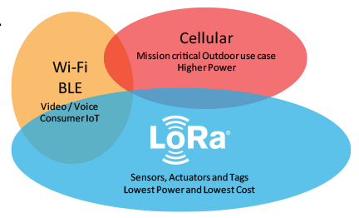
Why LoRa?

Slide 6
LoRaWAN Architecture

Slide 7
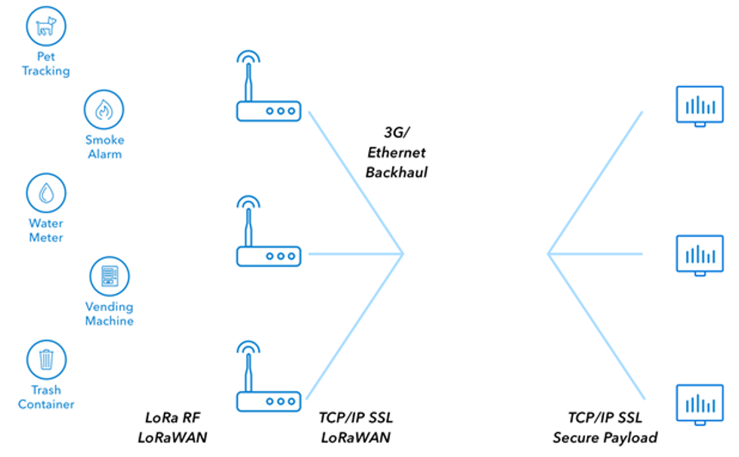

LoRaWAN Architecture
https://www.thethingsnetwork.org/docs/lorawan/architecture.html

Slide 8
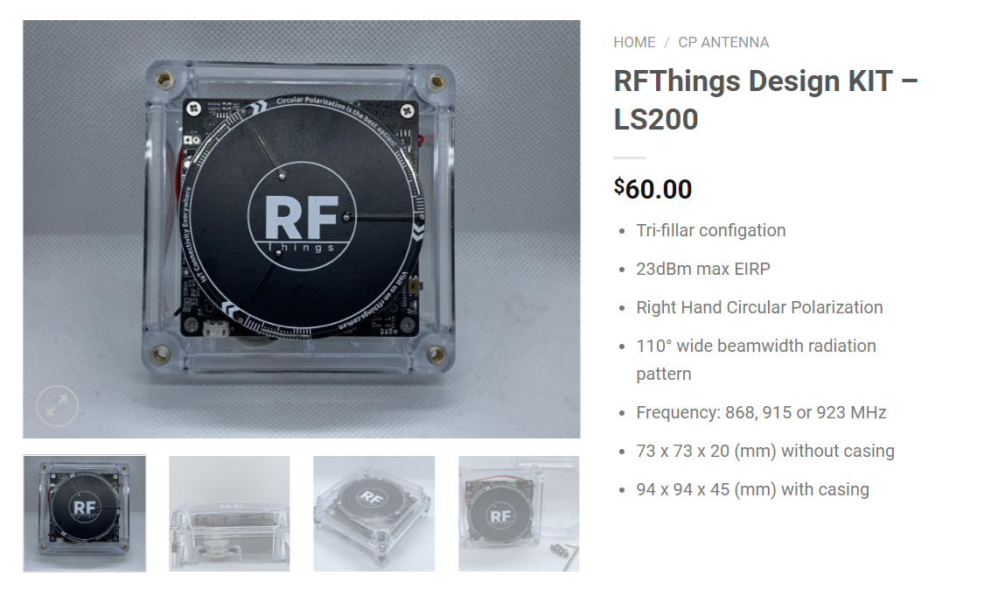
LoRaWAN Architecture
https://www.thethingsnetwork.org/docs/lorawan/architecture.html

Slide 9
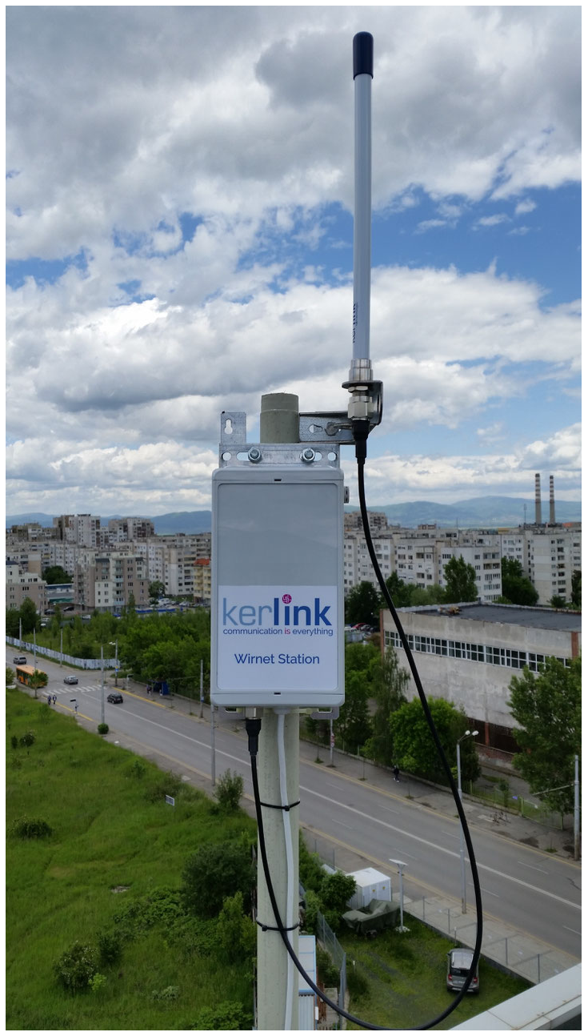
LoRaWAN Architecture
https://www.thethingsnetwork.org/docs/lorawan/architecture.html

Slide 10
LoRaWAN Architecture
https://www.thethingsnetwork.org/docs/lorawan/architecture.html

Slide 11
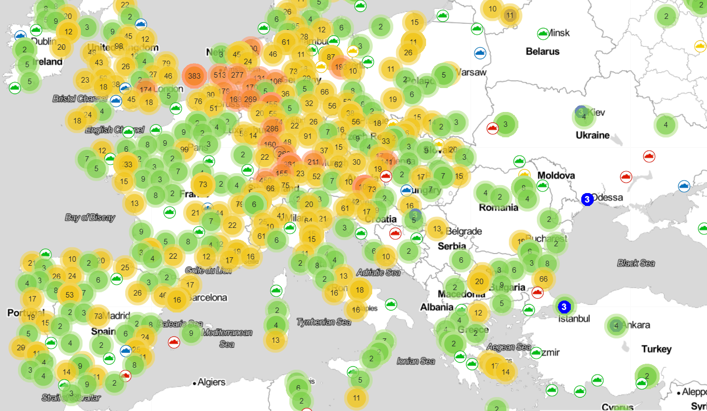
LoRaWAN Coverage Map
https://ttnmapper.org/

Slide 12
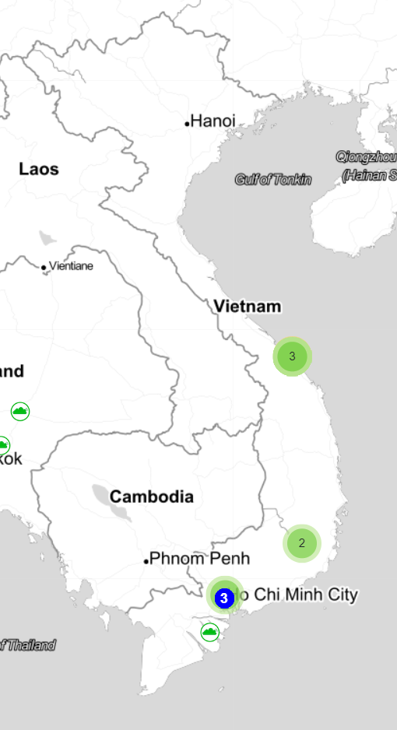
LoRaWAN Coverage Map
https://ttnmapper.org/

Slide 13
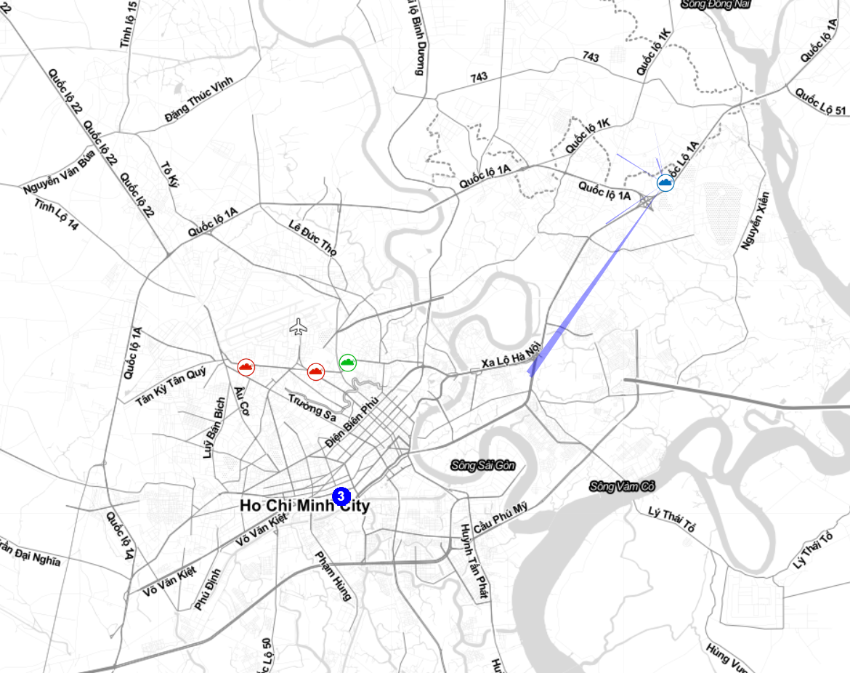
LoRaWAN Coverage Map
https://ttnmapper.org/

Slide 14
LoRaWAN Frequency Plans

Slide 15
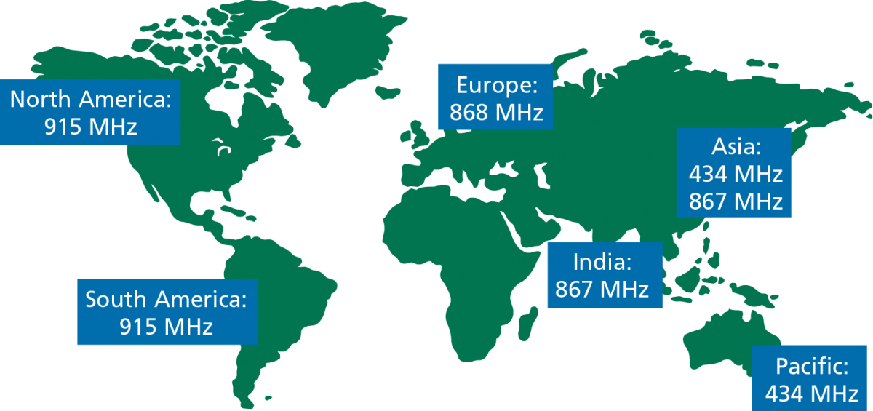
LoRaWAN Frequency Plans

Slide 16
LoRaWAN Frequency Plans
Plans: https://www.thethingsnetwork.org/docs/lorawan/frequency-plans.html
LoRaWAN® Regional Parameters: https://lora-alliance.org/resource-hub/rp2-101-lorawanr-regional-parameters

Slide 17
Hardware

Slide 18
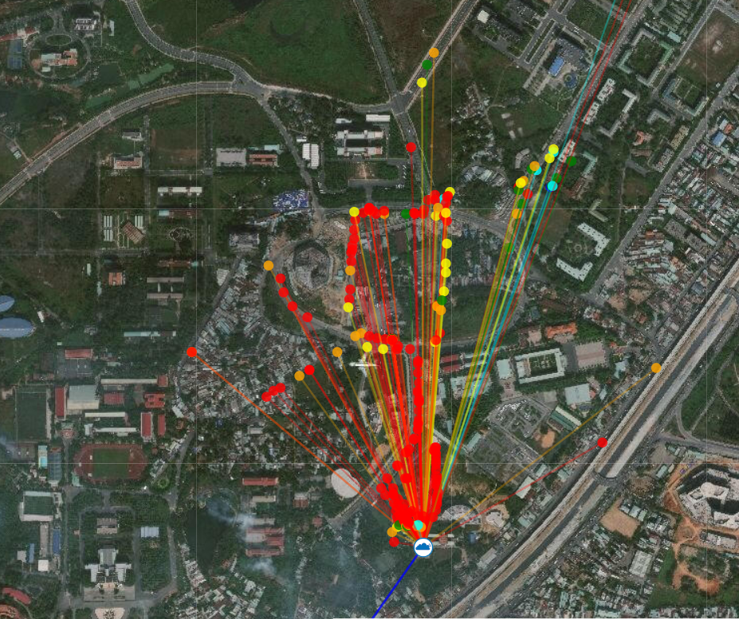
Hardware
Gateway: RAK7240

Slide 19
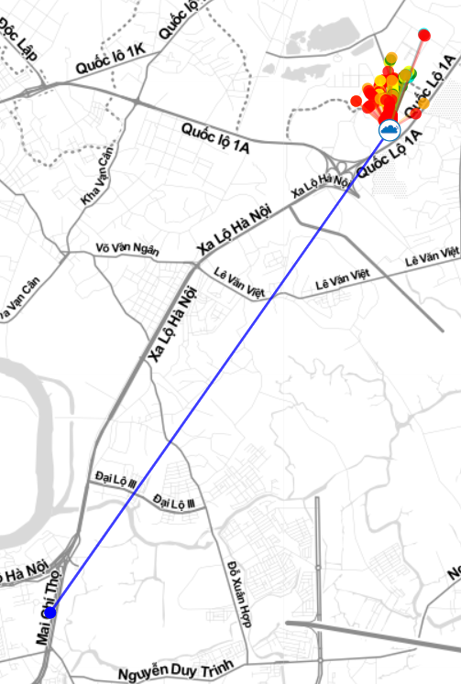
Hardware
Gateway: RAK7240

Slide 20
Hardware
Gateway: RAK7240
Node: UCA Education Board V3.5

Slide 21
Software/Libraries

Slide 22



LoRaWAN Network Server

Slide 23
Live Demo

Slide 24

Q&A
You can find me at thaonm@uit.edu.vn

Slide 25

For Further Information
RFThings Vietnam
Website: rfthings.com.vn/
Email: rfthings.vietnam@gmail.com

Slide 26

Thank you
Download this document at
bom.to/A7RKFQN

